Slide 1
Input and Interaction

Slide 2
Objectives
Introduce the basic input devices
Physical Devices
Logical Devices
Input Modes
Event-driven input
Double buffering for smooth animations
Programming event input with GLUT

Slide 3
Project Sketchpad
Ivan Sutherland (MIT 1963) established the basic interactive paradigm that characterizes interactive computer graphics:
User sees an object on the display
User points to (picks) the object with an input device (light pen, mouse, trackball)
Object changes (moves, rotates, morphs)
Repeat

Slide 4
Graphical Input
Devices can be described either by
Physical properties
Mouse
Keyboard
Trackball
Logical Properties
What is returned to program via API
A position
An object identifier
Modes
How and when input is obtained
Request or event

Slide 5
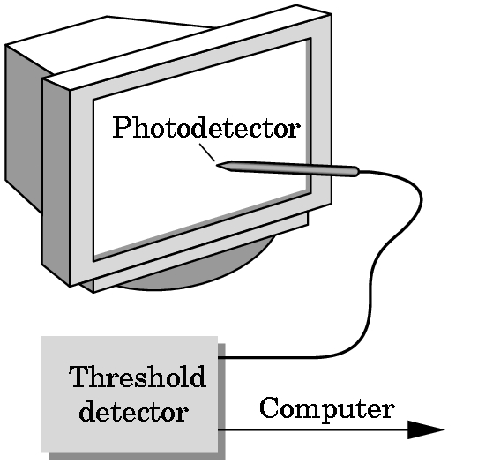
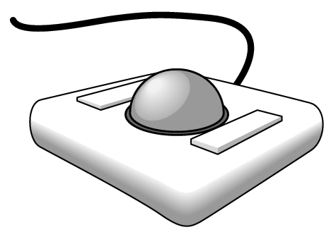
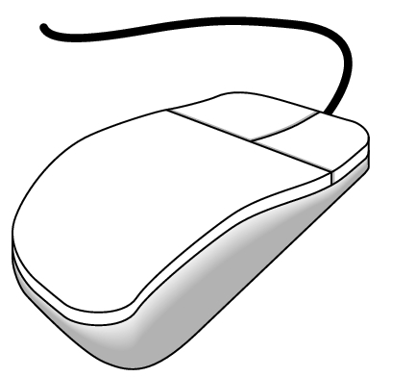
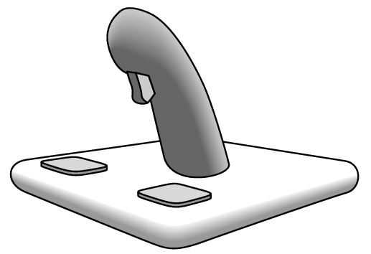
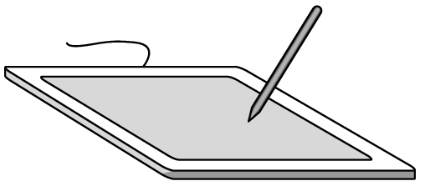
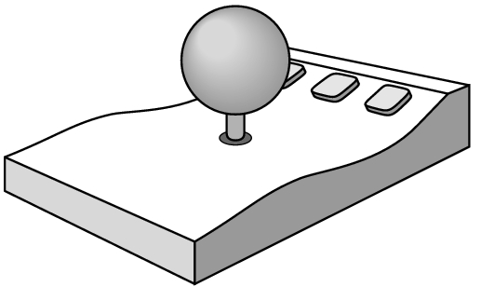
Physical Devices
mouse
trackball
light pen
data tablet
joy stick
space ball

Slide 6
Incremental (Relative) Devices
Devices such as the data tablet return a position directly to the operating system
Devices such as the mouse, trackball, and joy stick return incremental inputs (or velocities) to the operating system
Must integrate these inputs to obtain an absolute position
Rotation of cylinders in mouse
Roll of trackball
Difficult to obtain absolute position
Can get variable sensitivity

Slide 7
Logical Devices
Consider the C and C++ code
C++: cin >> x;
C: scanf (“%d”, &x);
What is the input device?
Can’t tell from the code
Could be keyboard, file, output from another program
The code provides logical input
A number (an int) is returned to the program regardless of the physical device

Slide 8
Graphical Logical Devices
Graphical input is more varied than input to standard programs which is usually numbers, characters, or bits
Two older APIs (GKS, PHIGS) defined six types of logical input
Locator: return a position
Pick: return ID of an object
Keyboard: return strings of characters
Stroke: return array of positions
Valuator: return floating point number
Choice: return one of n items

Slide 9
Input Modes
Input devices contain a trigger which can be used to send a signal to the operating system
Button on mouse
Pressing or releasing a key
When triggered, input devices return information (their measure) to the system
Mouse returns position information
Keyboard returns ASCII code

Slide 10
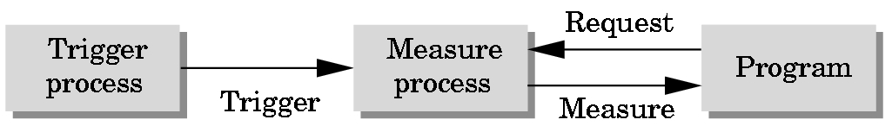
Request Mode
Input provided to program only when user triggers the device
Typical of keyboard input
Can erase (backspace), edit, correct until enter (return) key (the trigger) is depressed

Slide 11
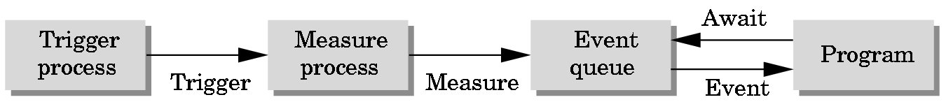
Event Mode
Most systems have more than one input device, each of which can be triggered at an arbitrary time by a user
Each trigger generates an event whose measure is put in an event queue which can be examined by the user program

Slide 12
Event Types
Window: resize, expose, iconify
Mouse: click one or more buttons
Motion: move mouse
Keyboard: press or release a key
Idle: nonevent
Define what should be done if no other event is in queue

Slide 13
Callbacks
Programming interface for event-driven input
Define a callback function for each type of event the graphics system recognizes
This user-supplied function is executed when the event occurs
GLUT example: glutMouseFunc(mymouse)
mouse callback function

Slide 14
GLUT callbacks
GLUT recognizes a subset of the events recognized by any particular window system (Windows, X, Macintosh)
glutDisplayFunc
glutMouseFunc
glutReshapeFunc
glutKeyboardFunc
glutIdleFunc
glutMotionFunc, glutPassiveMotionFunc

Slide 15
GLUT Event Loop
Recall that the last line in main.c for a program using GLUT must be
glutMainLoop();
which puts the program in an infinite event loop
In each pass through the event loop, GLUT
looks at the events in the queue
for each event in the queue, execute the appropriate callback function if one is defined
if no callback is defined for the event, the event is removed from the queue and ignored

Slide 16
The display callback
The display callback is executed whenever GLUT determines that the window should be refreshed, for example
When the window is first opened
When the window is reshaped
When a window is exposed
When the program requests a display event
In main.c
glutDisplayFunc(mydisplay) identifies the function to be executed
Every GLUT program must have a display callback

Slide 17
Posting redisplays
Any function can call the display callback function
Can lead to multiple executions of the display callback on a single pass through the event loop
We can avoid this problem by instead using
glutPostRedisplay();
which sets a display flag.
GLUT checks to see if the display flag is set at the end of the event loop and if so the display callback function is executed

Slide 18
Animating a Display
When we redraw the display through the display callback, we usually start by clearing the window
glClear()
then draw the altered display
Problem: the drawing of information in the frame buffer is decoupled from the display of its contents
Graphics systems use dual ported memory
Hence we can see partially drawn display
This flashing of partial images is visually distracting

Slide 19
Double Buffering
Instead of one color buffer, we use two buffers
Front Buffer: one that is displayed but not written to
Back Buffer: one that is written to but not displayed
Program then requests a double buffer in main.c
glutInitDisplayMode(GL_RGB | GL_DOUBLE)
At the end of the display callback buffers are swapped
void mydisplay()
{
glClear(GL_COLOR_BUFFER_BIT|….)
/* draw graphics here */
glutSwapBuffers()
}

Slide 20
Using the idle callback
The idle callback is executed whenever there are no events in the event queue
glutIdleFunc(myidle)
Useful for animations
void myidle() {
/* change something */
t += dt
glutPostRedisplay();
}
void mydisplay() {
glClear();
/* draw something that depends on t */
glutSwapBuffers();
}

Slide 21
Using globals
The form of all GLUT callbacks is fixed
void mydisplay()
void keyboard(unsigned char key, int x, int y)
void mymouse(int button, int state, int x, int y)
Must use global variables to pass information to and from these callback functions

